Slide 1
INB255: Security
Semester 1, 2014
Lecture 10

Slide 2
Outline
Computer crime and computer forensics
CF Process
Digital Evidence
Devices
Disk Systems
Computer Based Records
Challenges for Computer Forensics
2

Slide 3
Computer Crime
What is computer crime?
Cybercrime, electronic crime
Types of crimes
Hacking (in the illegal sense), malware, viruses, DOS & DDOS attacks, phishing attacks
Copyright infringement, loss of confidential information
Computer based fraud
Child pornography, child grooming
Harassment, cyber bullying, cyber stalking
Cyberterrorism
Cyberwar
Spam
Drug trafficking
And the list goes on …
3

Slide 4
Computer Crime
Time | Technology | Crime
1950 | Transistors | None
1960 | Commercial applications | Some fraud ½ cent rounding
1970 | Silicon 10 baud lines Databases ARPANET | Insider crime Outsider crime Hacking
1980 | Personal Computers Telnet LAN/WAN | Security standards Trusted systems Stolen hardware Copyright violation Viruses
1990 | Internet goes public The Web | Online fraud Web pornography Cyberstalking Website hacking Information warfare Identity theft Email abuse
2000 | Broadband Mobile phones Wireless VoIP | .. all of the above plus Spam Cyberterrorism IT-enabled armies and more

Slide 5
Computer Crime
Costs
Difficult to pin down
Estimate of $114 billion per year
Symantec study
Add another $274 billion in time lost while trying to recover
Norton cybercrime study
< 10% of computer crime is reported
fewer than 2% of these result in convictions

Slide 6
Computer Crime
Classification
Motive
Target
Role of Computer
As a tool to commit the crime
As the target of the crime
As a repository of information about crime
6

Slide 7
Computer Forensics
Traditional forensic science
identifiable raw material
techniques derived from physical sciences
unified body of theory
techniques yield to research methods
standardised tests
Computer forensics
raw material is an artefact
techniques are not “discoveries”
no standardised tests
growing number of accredited laboratories and practitioners
7

Slide 8
Computer Forensics
an investigative activity employing a set of scientifically derived methods that attempt to anticipate, discover and reconstruct the sequence of events arising from some computer-based activity that is potentially a violation of the law or acceptable use policies
the science of using and analysing information stored, transmitted or produced by a computer or network to reason about the validity of hypotheses attempting to explain the circumstances or cause of the activity under investigation, in a manner intended to meet evidentiary requirements
8

Slide 9


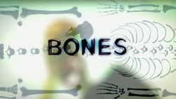

CF in the Popular Media

Slide 10
CF Reality
There are no “smoking guns”
Evidence is circumstantial (at best) not direct evidence of a crime
Investigators require
familiarity with specific OS
familiarity with multiple OS
experience with a range of tools
skill at organising large collections of different information
retrieval expertise for deleted and residual data
skills in court case preparation and giving evidence or opinion
10

Slide 11
CF Reality
Competent analysis can take days, weeks or months
Depends on
Amount of data
Importance of case
Budget
Examiner will look at remnants of everything that is on a disk or device
Emails
Websites
Chat sessions
Phrases searched for
Imagine if that was your disk or device…

Slide 12
Criminal vs Civil
Criminal cases
Laws (state, federal, etc) broken
Law enforcement has detected the crime
Presumption of innocence
Prosecution must prove case otherwise
Civil cases
A party claims damages of some sort (plaintiff)
Plaintiff must prove on the balance of probabilities that their claim is just

Slide 13
Computer Forensics Process
Identify
Where and what is relevant evidence
Secure
Remove from scene (unusual to do this now)
Remove people from scene
Record scene – still and video camera
To “pull the plug” or not
Statically linked tools
Copy without alteration
Write blockers
Validate and Verify – One Way Hash Functions
Chain of Custody

Slide 14
Computer Forensics Process
Analyse
Determine meaning of evidence
Discover intent
Hash databases
Hidden files
File authorship
Timelining
Searching – keywords, file signatures
Password Cracking
Present
Report on process and findings
What does it mean in context of case
Possibly in a court of law

Slide 15
Computer Forensics Process
Specialist Tools Required
Disk and device imaging
Copy entire disk – not just files visible to Operating System
Verification tools
All data passed through 1 way hash (MD5, SHA1)
Analysis Tools
Forensic Suites – EnCase, FTK, Winhex, etc
Numerous single purpose tools
File viewers, Scalpel, Web browser data extraction, file recovery, Rifuiti (recycle bin analysis), Pasco (IE browser analysis)

Slide 16
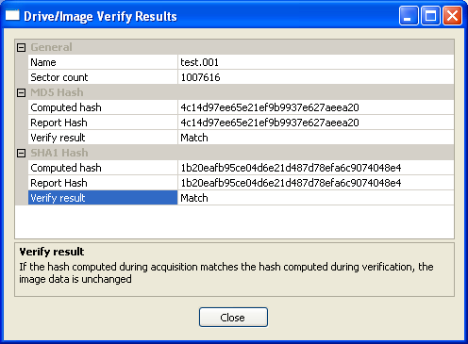
Computer Forensics Process

Slide 17
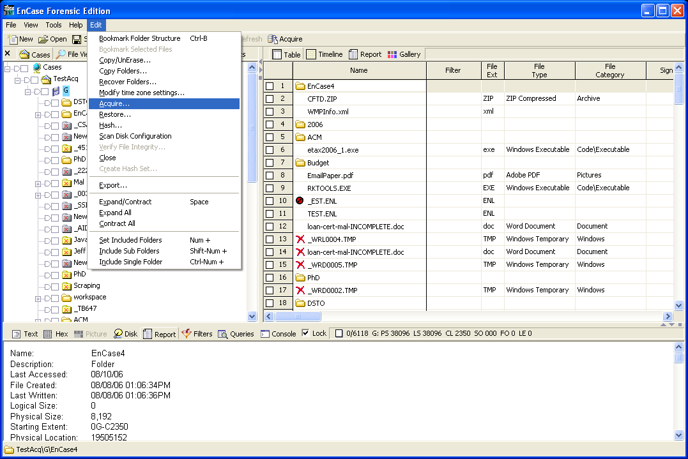
Computer Forensics Process

Slide 18
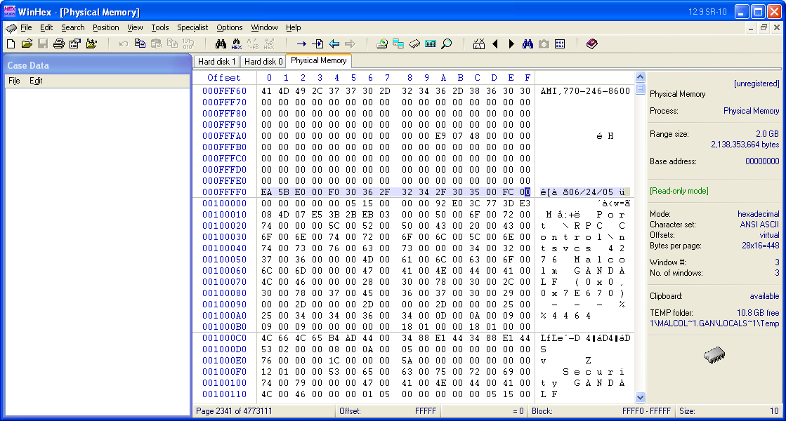
Computer Forensics Process

Slide 19
Digital Evidence
Any information of probative value that is either stored or transmitted in a digital form
Challenges
Vast quantity
Easily contaminated
Crime may not be identified for months (years)
May be a vast number of potential suspects

Slide 20
Digital Evidence
Must satisfy legal requirements
Authentic
original, relate to the crime
Reliable
collected properly
Complete
may be used to prove guilt as well as innocence
Believable
be convincing to a jury and presented so it makes sense
Admissible
collected using procedures conforming to common law

Slide 21
Digital Evidence
Where can you get digital evidence?
Desktops, laptops, servers
PDAs
iPods, iPads, tablets, etc
Cameras, memory cards
Phones, phone records
Web browsers
Email servers
Logs and databases

Slide 22
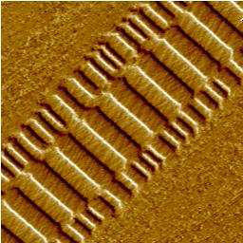
Digital Evidence
What can you get?
Ghost (overwritten) data
Magnetic Force Microscopy
Not particularly feasible, but…
Garbage retrieval
Print spoolers, swap files, cache, recycle bins
Web browser information
Web browsing history, cache
Passwords!
Credit Card numbers!
Web searches!

Slide 23
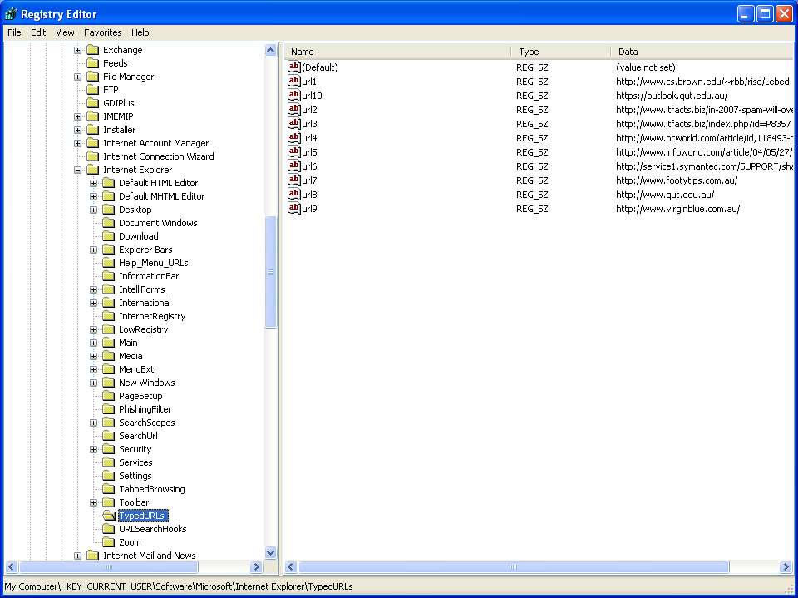
Digital Evidence
Registry stores Typed URLs

Slide 24
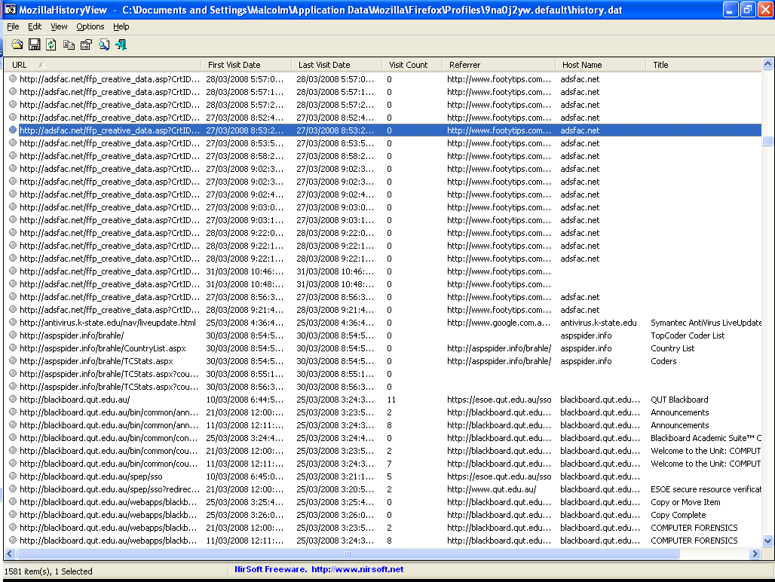
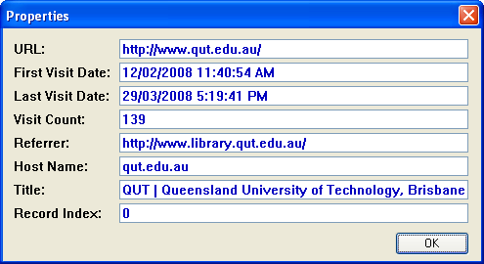
Web Browser Forensics

Slide 25
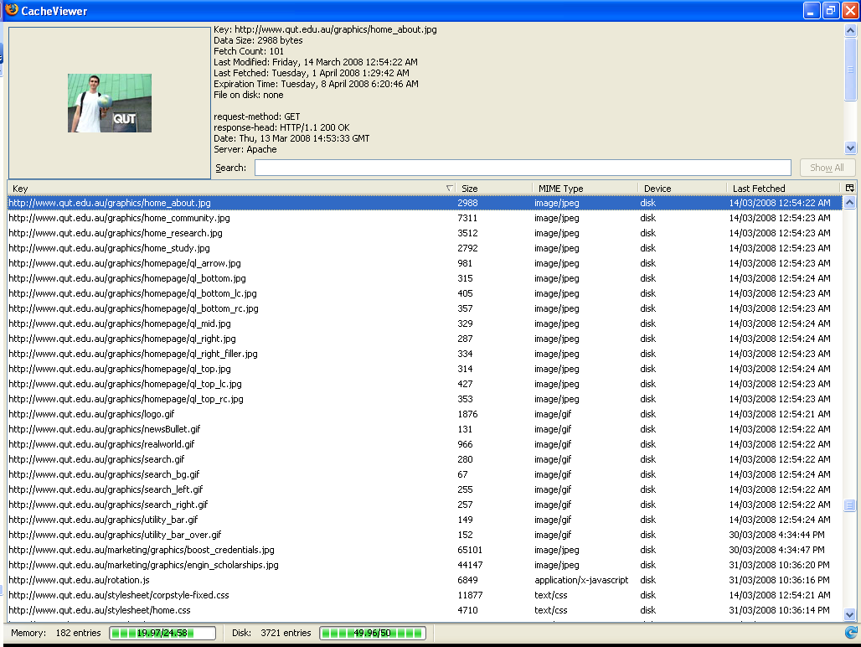

Slide 26
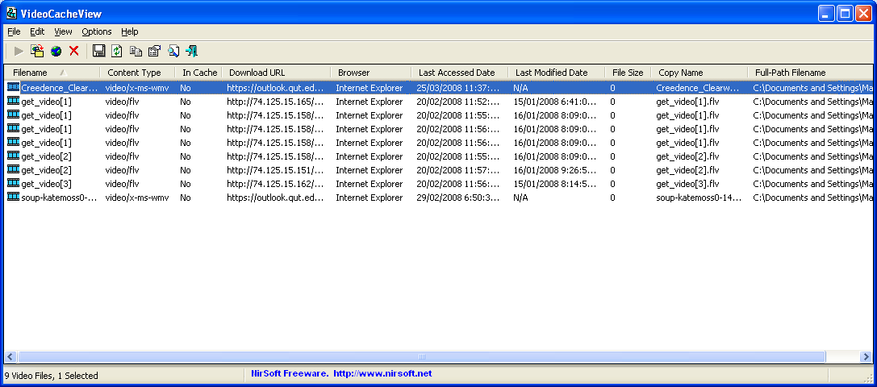
Digital Evidence
VideoCacheView
http://www.nirsoft.net/utils/video_cache_view.html

Slide 27
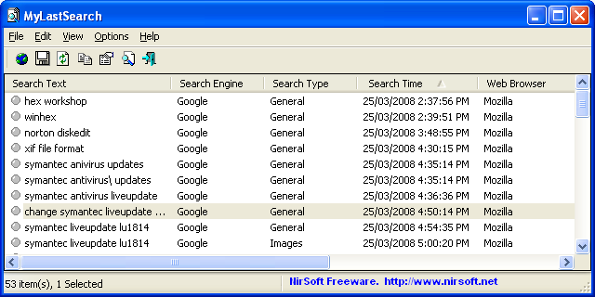
Digital Evidence
MyLastSearch
http://www.nirsoft.net/utils/my_last_search.html

Slide 28
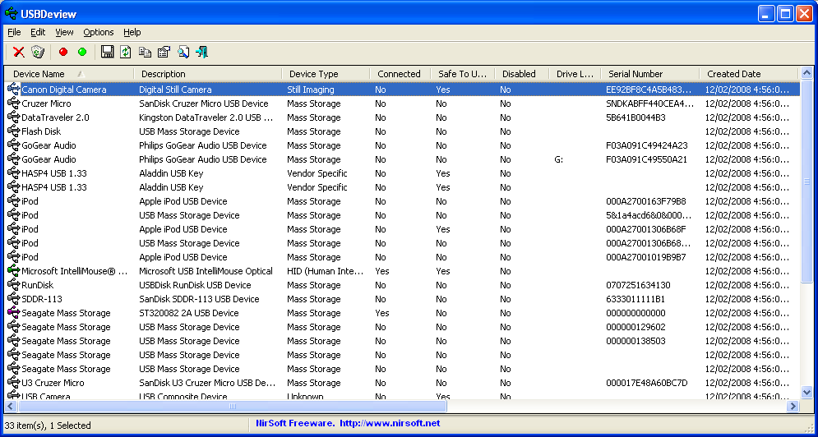
Digital Evidence
Windows Registry
Contains listing of all USB devices connected to the machine
NirSoft USBDeview
http://www.nirsoft.net/utils/usb_devices_view.html
Serial Numbers

Slide 29
Digital Evidence
“Your Life’s in a database at ASIO”
Redgum
Phone companies
Frequent Flyer programs
Airlines, supermarkets, retailers, etc
Banks, road tolls, public transport
Health, taxation records
E-tax database linking

Slide 30
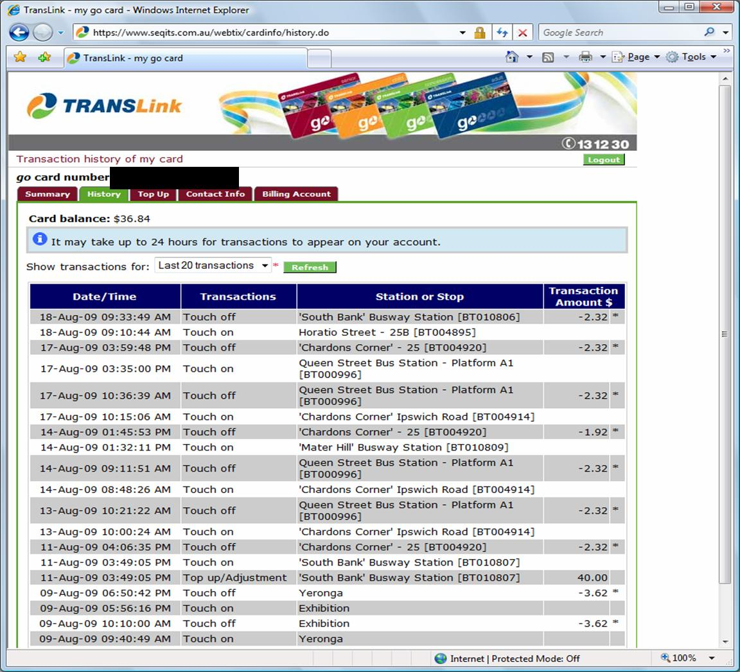

Slide 31
Digital Evidence
Complexity
Data acquired at lowest level
Needs abstraction
Abstracted Views
Physical Media – head, cylinder, sector
Disk Management – partition table, partitions
File System – boot sector, FAT, MFT
Application – ASCII, HTML, proprietary, databases, binary etc.

Slide 32
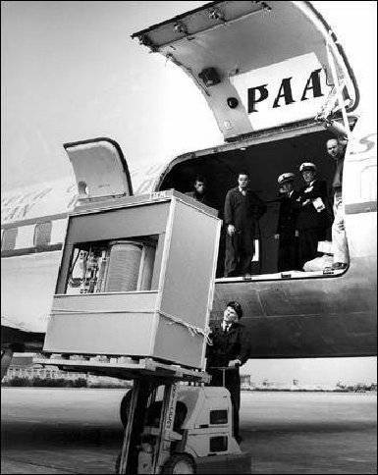
What Am I?

Slide 33
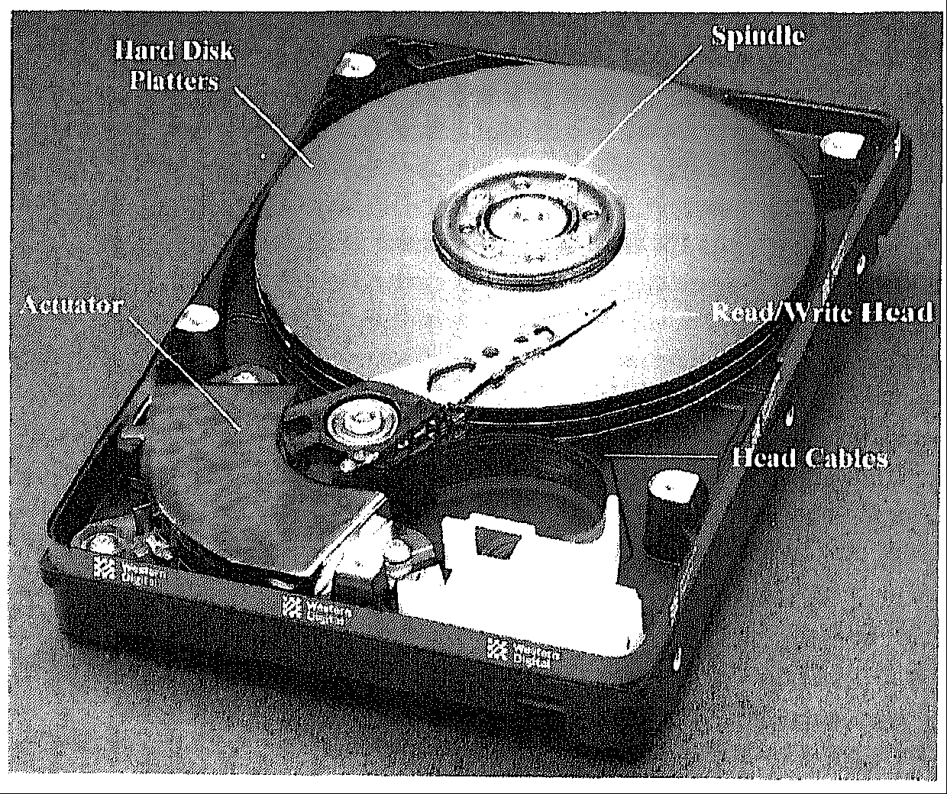
Disk Systems
Sammes and Jenkinson, 2000

Slide 34
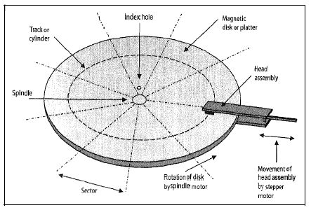
Disk Systems
Sammes and Jenkinson, 2000

Slide 35
Disk Systems
quote from Seagate (1995)
“Today’s new generation of disc drives achieve the engineering equivalent of a Boeing 747 flying at Mach 4 just two metres above the ground, counting each blade of grass as it flies over.”
1995 best disks were ~2 GB
2014
2 TB disks are common, 4 TB on market
New disk materials technology
2017
???
IBM store 1 bit in 12 atoms
http://www-03.ibm.com/press/us/en/pressrelease/36473.wss

Slide 36
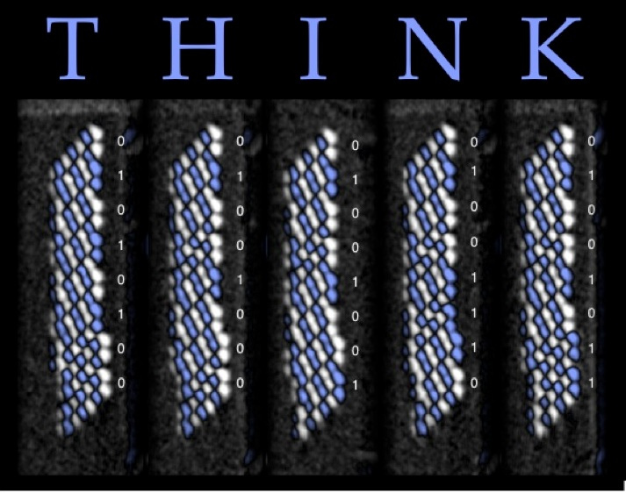
Disk Systems

Slide 37
Disk Systems
Hard disk structure
Platters
Sections
Tracks
Sector (single section of a track)
512 bytes
Clusters (group of sectors)
Smallest unit available
Files
Written onto one or more clusters
Slack Space
What is left over at the end of a cluster

Slide 38
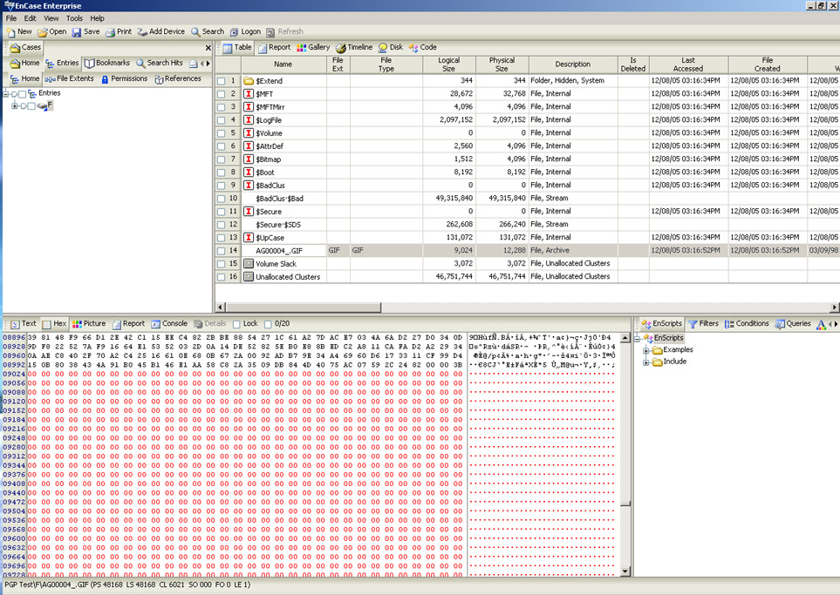
Disk Systems

Slide 39
Challenges for Forensics
Disk size
Imaging, analysis, searching
Selective imaging, arrays of analysis machines
Devices
A multitude of different types
No standardization
Not designed with forensics in mind

Slide 40
Challenges for Forensics
Encryption
Password cracking
Build password lists
Brute force (exponential complexity)
Rainbow tables
The Cloud
Jurisdiction
Just where is the data?
Is the cloud forensically ready?
Are current procedures suitable?

Slide 41
Challenges for Forensics
Steganography
Message hiding in other documents
Text (not common)
Picture files (GIFs, BMPs, JPGs)
Audio files (WAVs)
Steganographic File System
StegFS
Multiple copies of data required due to collisions
Currently no way of detecting its presence

Slide 42

Challenges for Forensics
key
key
This is some message text that we want to hide in the picture using steganography. Any length message can be stored in the cover, but if it is too long, there may not be enough space in the cover to ensure that the cover file stays the same size.
cover
Embedding
Extraction
stego-content
message
message
This is some message text that we want to hide in the picture using steganography. Any length message can be stored in the cover, but if it is too long, there may not be enough space in the cover to ensure that the cover file stays the same size.
Alternatively, asymmetric key encryption can be used

Slide 43


Challenges for Forensics
Original GIF – no hidden data
(total size = 20.4 KB)
Contains 6.67 KB hidden data
(total size = 21.1 KB)

Slide 44


Challenges for Forensics
Original bmp – no hidden data
(total size = 92.9 KB)
Contains 6.67 KB hidden data
(total size = 92.9 KB)

Slide 45
Questions?
45

